Slide 1
Mallet
An intercepting proxy for arbitrary protocols
Rogan Dawes

Slide 2
Am I in the Right Track?
Presentation and demonstration of Mallet, a framework for creating intercepting proxies for arbitrary protocols
Written in Java, based on Netty
Scriptable in any JSR-223-compliant language
Full open source release

Slide 3
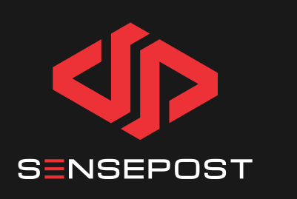
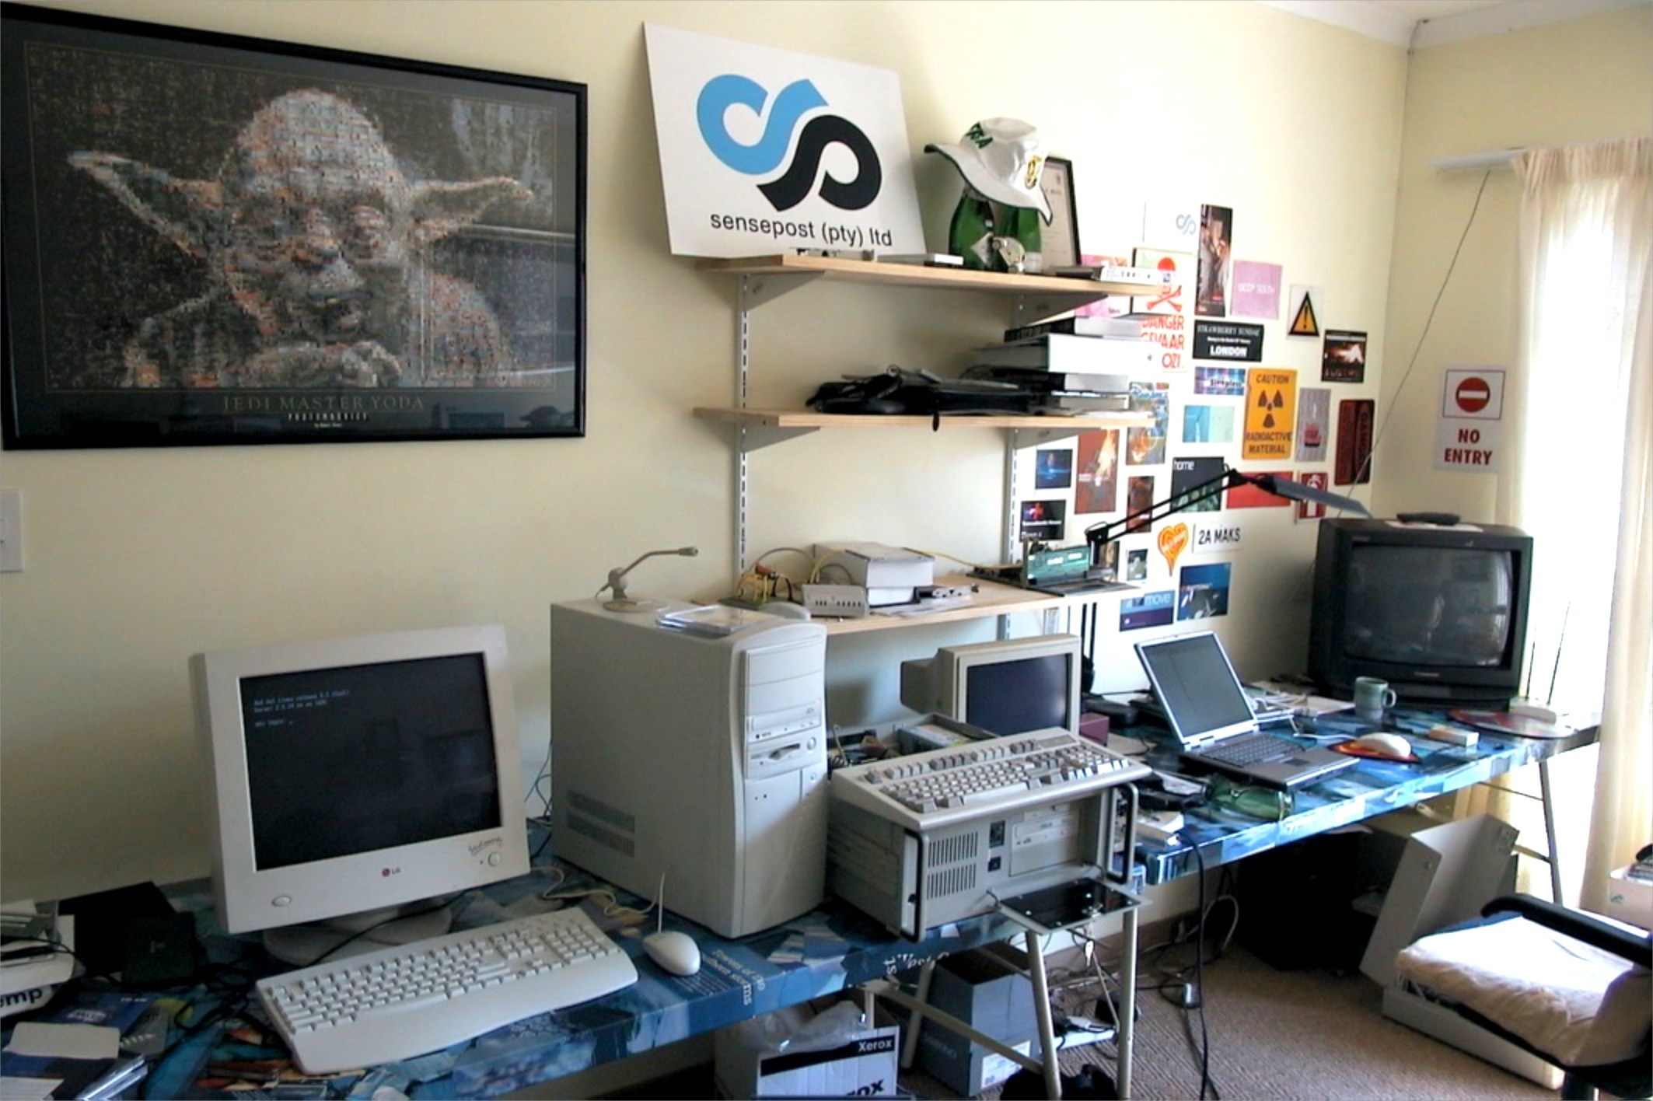

London
England
Rogan Dawes
rogan@sensepost.com
Researcher
Pretoria & Cape Town, South Africa
Notes:
We’re SensePost – an information security consultancy
We started in 2001 in Roelof’s bedroom
On the 14th of Feb, so you can guess they were all single
We have a presence in Pta, Cape Town and LDN
We perform security assessments, help people build secure systems, provide managed security automation services such as vuln scanning and phishing and provide a training curriculum
My name is Rogan Dawes, I’m a researcher and have been writing proxies since around 2002. Sometimes it feels that a proxy is a solution to every problem
For example, I also created USaBUSe, that proxies shells over USB Keyboards!
You can reach me at those addresses

Slide 4

Notes:
Communication between systems is a fundamental of modern applications, a good chunk of which is done using HTTP and HTTPS
However, what can we do about the applications that don’t use HTTP/HTTPS? Shrug and call it good? No way!
Subversion of that communication can result in unintended access, just like it can when tampering with HTTP.
In fact, intercepting non-HTTP protocols often takes you back to the 90’s, simply because these apps often haven’t been properly audited from a comms perspective.
Something we have seen for almost two decades in the HTTP space, starting with Achilles in 2000.

Slide 5
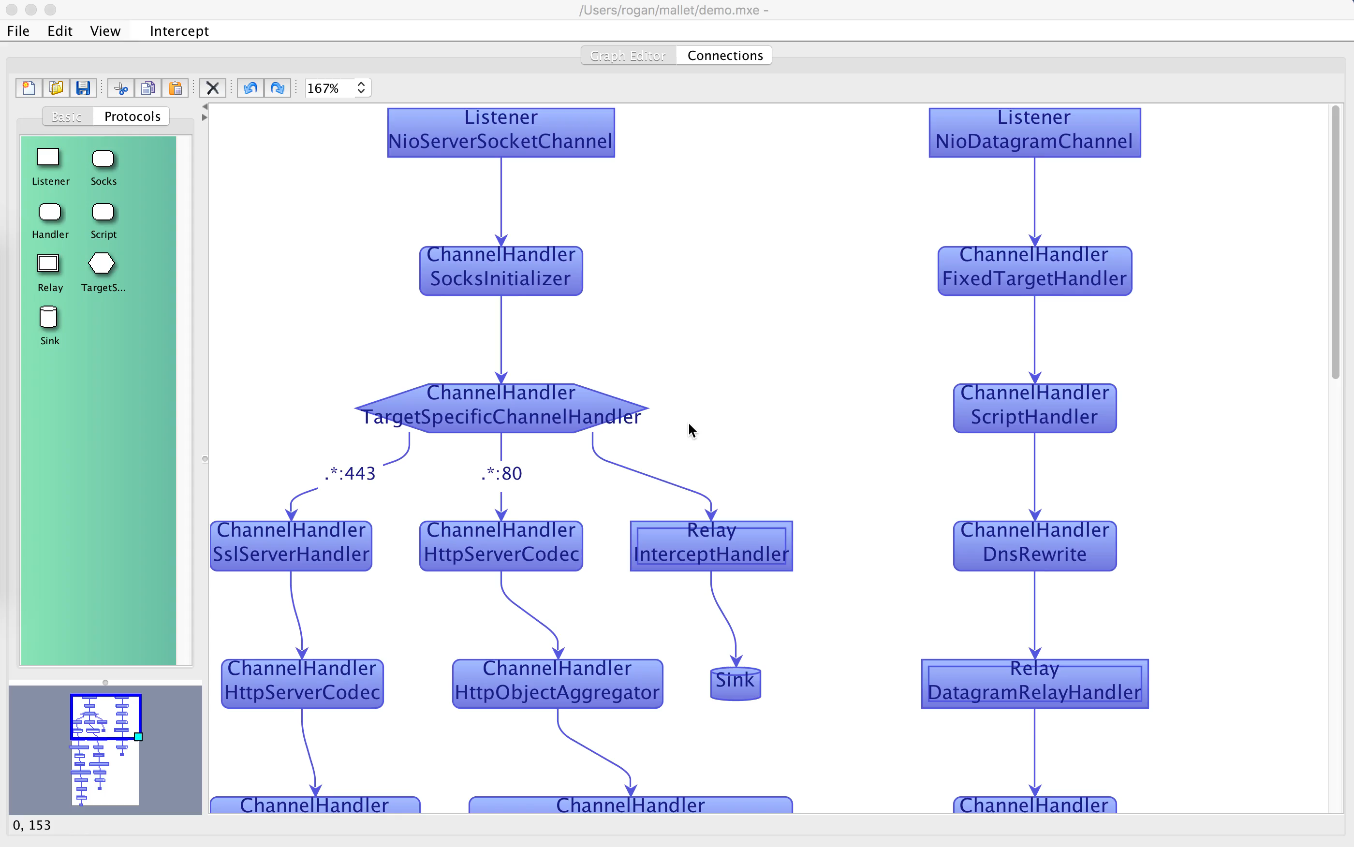
Demonstration
Notes:
This video shows the Protocol graph component of Mallet. There is a TCP graph on the left, and a UDP graph on the right.
The TCP graph is configured with handlers for port 443 (SSL, HTTP, WebSockets), port 80 (HTTP+WebSockets), and then everything else, while the UDP graph is configured with DNS handlers.
The demonstration shows a command line websockets client making a connection to the websockets.org echo server, sending a message, and getting the identical message echoed back.
Next, we wrap the websockets client, intercepting its communications, and redirecting it through Mallet.
Now when we send the same message, it comes back in uppercase, due to a tamper script in Mallet, that specifically focuses on TextWebsocketFrame’s.
Finally, to demonstrate the UDP functionality, I do a hostname lookup against the Mallet UDP listener. It is configured to parse DNS requests and responses, and relay them to Google DNS. In this demonstration, I do a “dig” for google.com, but the answers that come back are for www.sensepost.com instead.

Slide 6
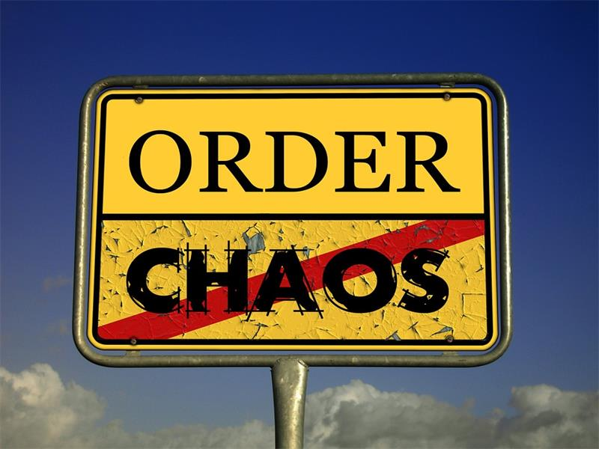
Notes:
Why is intercepting arbitrary protocols hard?
- HTTP(S) is a fairly simple protocol. It’s well defined, stateless, Request/Response based protocol. To a large extent, requests can be independently replayed, on a different socket, with little fundamental changes required. (Excluding things like NTLM auth, but still).
- Arbitrary protocols have additional considerations, like sequence (who talks first), connection/session state, data timeouts, delimiting messages/frames, etc.
- Most proxies for arbitrary protocols are once-off, hard-coded implementations for a specific instance, often not shared/sharable. Or else wrappers around socat!

Slide 7
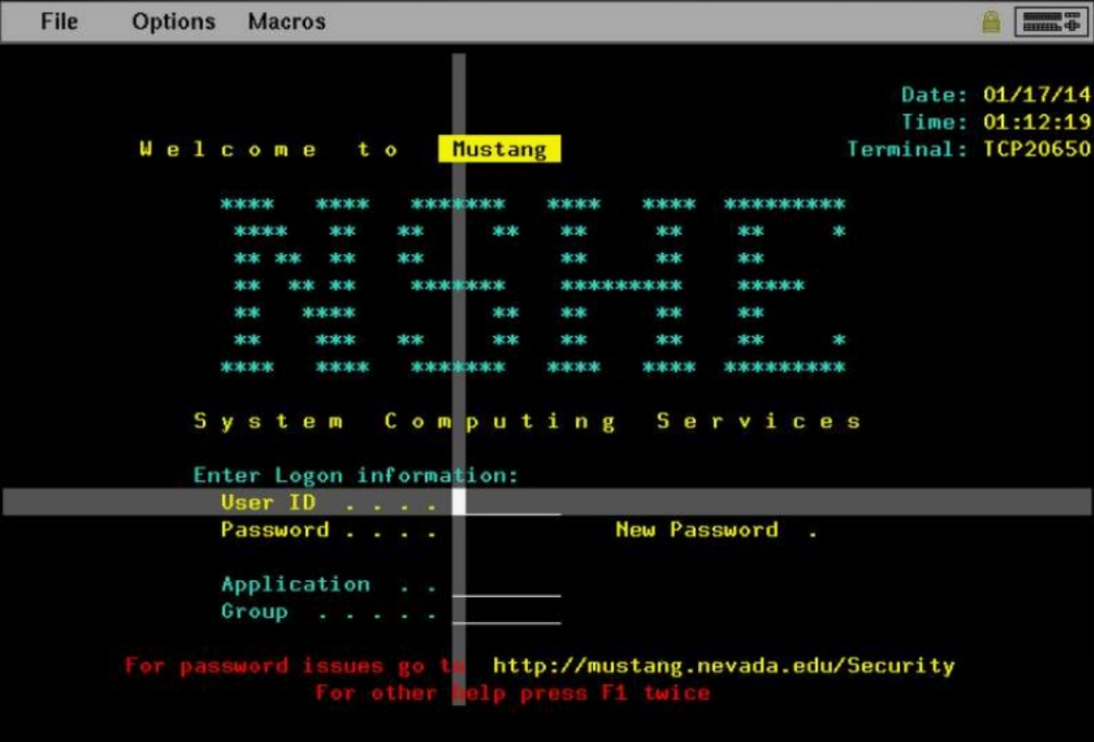
Notes:
Example of a protocol with demonstrated vulnerabilities (TN3270)
Hidden fields, read-only fields, etc. Things we’ve been attacking for years on the web using an intercepting HTTP proxy, that have been out of our reach for other protocols.
Granted, there will be a fair amount of work required to implement a TN3270 protocol codec. But you won’t have to do the SSL part, and you won’t have to worry about the TCP Listener, and the message forwarding, etc, etc

Slide 8
Prior work
OWASP Proxy (a library for writing proxies)
Martin Holst Swende - Hatkit Proxy
Intrepidus Group’s Mallory (2010!)
jcrugzz/tcp-proxy
ickerwx/tcpproxy
praetorian-inc/Trudy
Simone Margaritelli - Bettercap
summitt/Burp-Non-HTTP-Extension
Notes:
Common pattern is complex installation (Virtual machines, iptables rules, PPTP servers, etc), and limited protocol support (mostly HTTP/S), and 1-2 additional protocols at a demonstration level

Slide 9


Notes:
I wanted it to be as easy to use as possible, not requiring Virtual Machines, IPTables rules, and routing changes just to get traffic to the application.
And I wanted there to be a large body of existing protocol support, so that you don’t have to reinvent the wheel

Slide 10



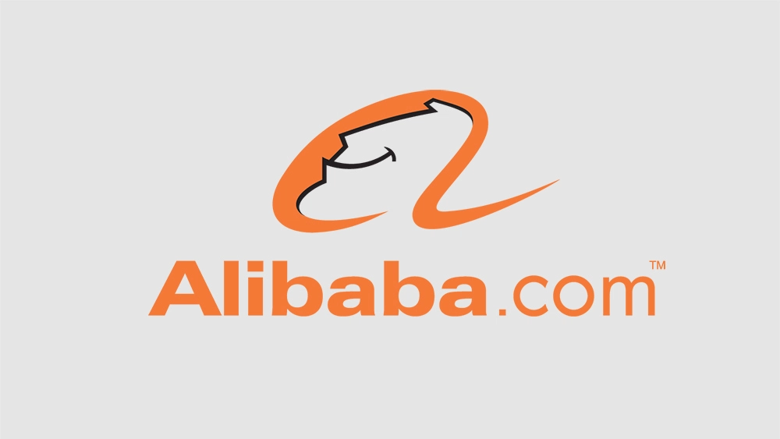
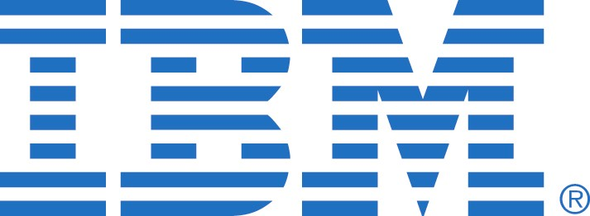
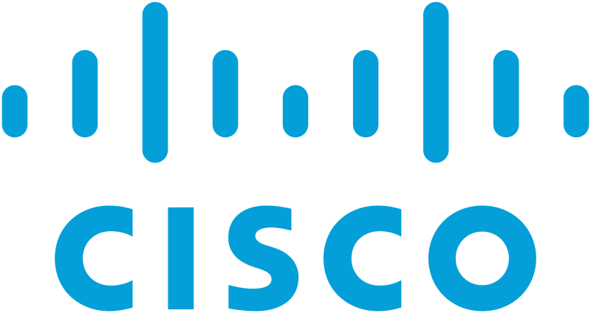
Netty Project
Netty is an asynchronous event-driven network application framework for rapid development of maintainable high performance protocol servers & clients.
… designed carefully with the experiences earned from the implementation of a lot of protocols such as FTP, SMTP, HTTP, and various binary and text-based legacy protocols.
Evolved over last 15 years!
Notes:
- A mature (2002!), high performance (10's of Petabytes/day at Apple, 400,000 instances)
- In use by MANY large companies (https://netty.io/wiki/adopters.html)
- Lots of existing Protocol Decoders/Encoders, and body of knowledge/support for creating new ones!
Great programming model supports "construction of pipelines" through composition, rather than by wrapping as was done in OWASP Proxy

Slide 11
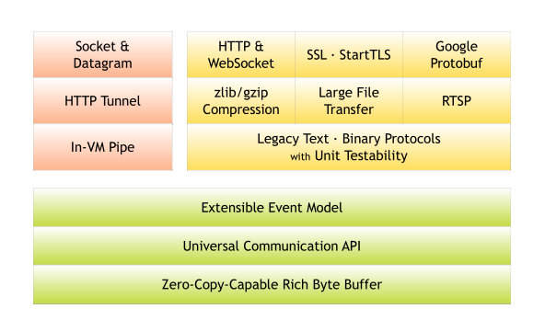
Notes:
This slide simply illustrates the breadth of protocol support that the Netty framework has

Slide 12
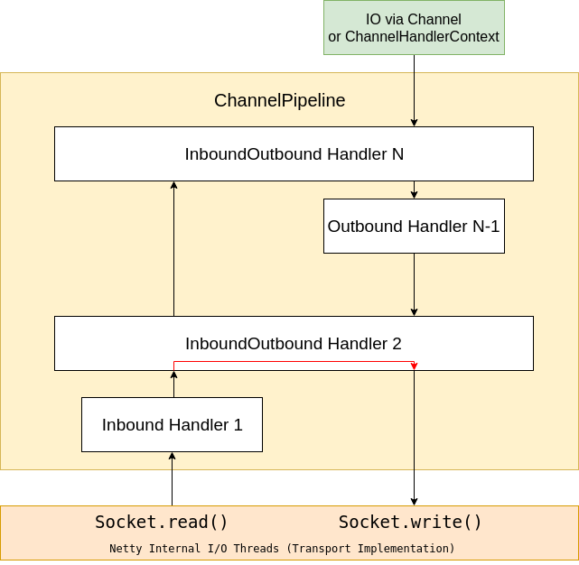
Notes:
This illustrates some features of the Channel Pipeline, that it is composed of a number of handlers in sequence, that can choose to handle incoming events, or outgoing events, or both.
Handlers can either process the incoming event and forward it, or respond to it directly.

Slide 13
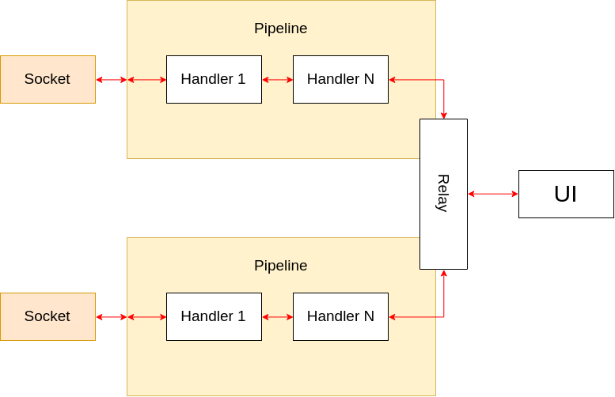
Notes:
This illustrates how to construct a proxy using two pipelines, by sharing a Relay handler between two pipelines.
This is also responsible for making the messages available to the UI, where they can be viewed, edited and forwarded.

Slide 14

Notes:
One of the ways Mallet makes it easy to intercept traffic is by making use of Netty’s built-in Socks protocol support
That makes it trivial to intercept most TCP-based traffic, using tools such as tsocks, proxychains, etc, on Linux/OS X, and ProxyCap et al on Windows
It is far simpler to configure tsocks or proxychains, and wrap the applications you are trying to intercept.

Slide 15
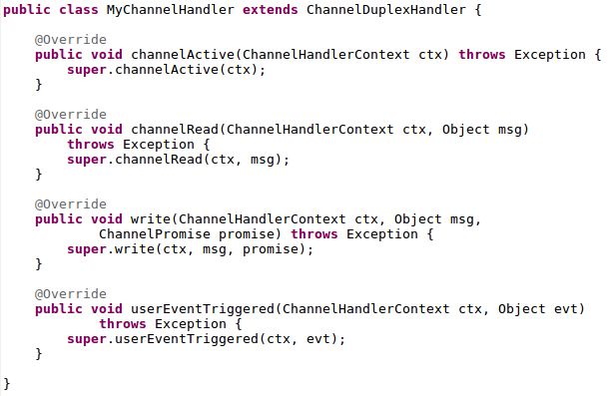
Notes:
This just illustrates the main methods that you may wish to override when writing a Handler.
There are others in the interface, but these are likely to be the most useful.

Slide 16
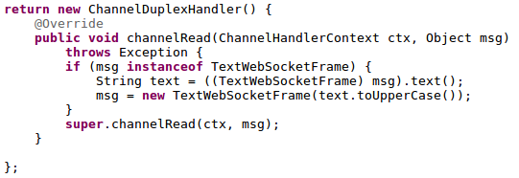
Notes:
Just an illustration of how little work it actually is to make some custom changes to a message
This makes the text in a TextWebSocketFrame uppercase.

Slide 17


Slide 18
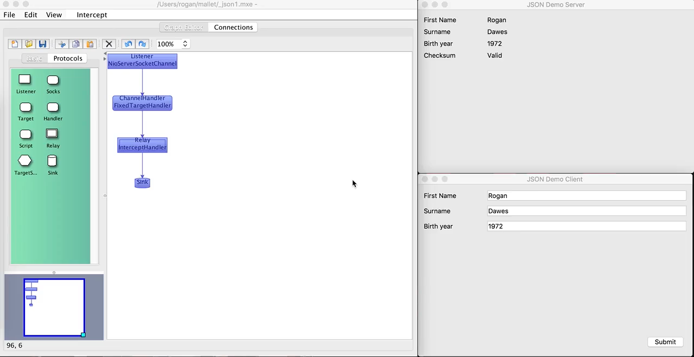

Slide 19
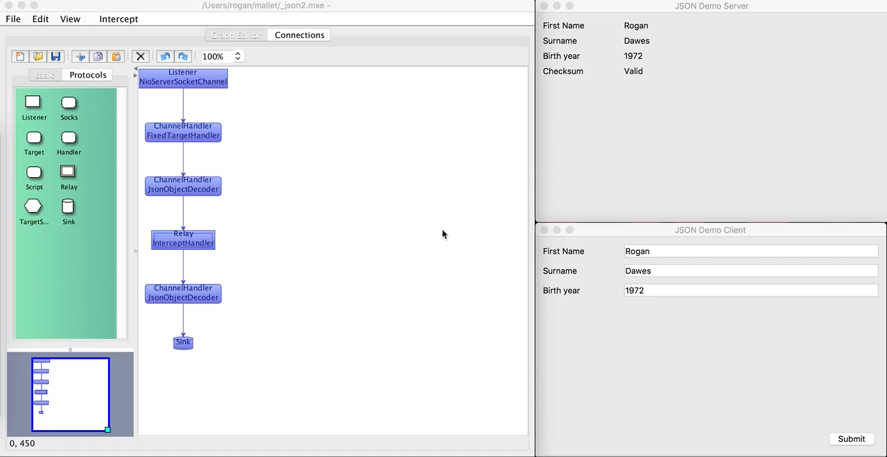

Slide 20
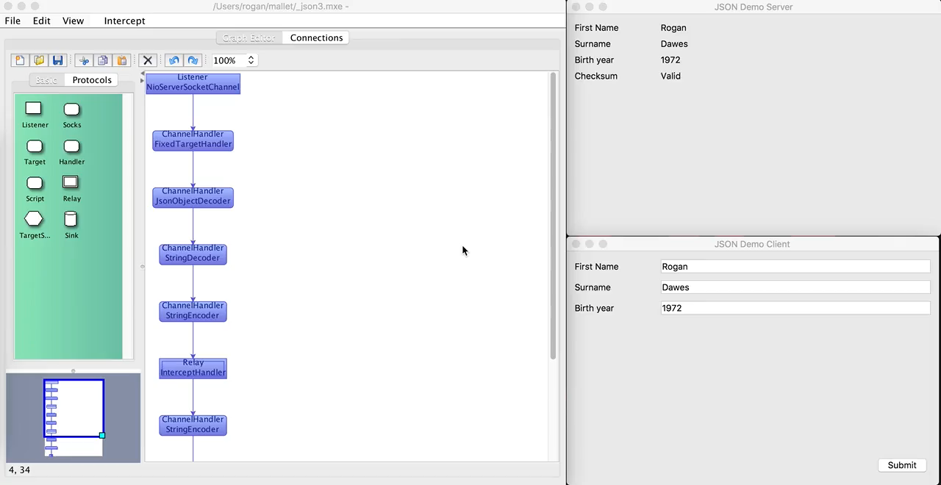

Slide 21
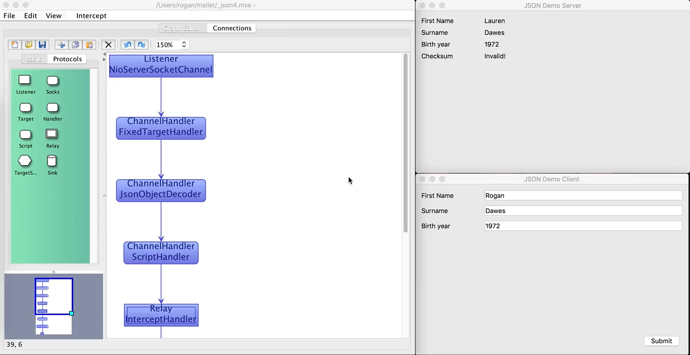

Slide 22
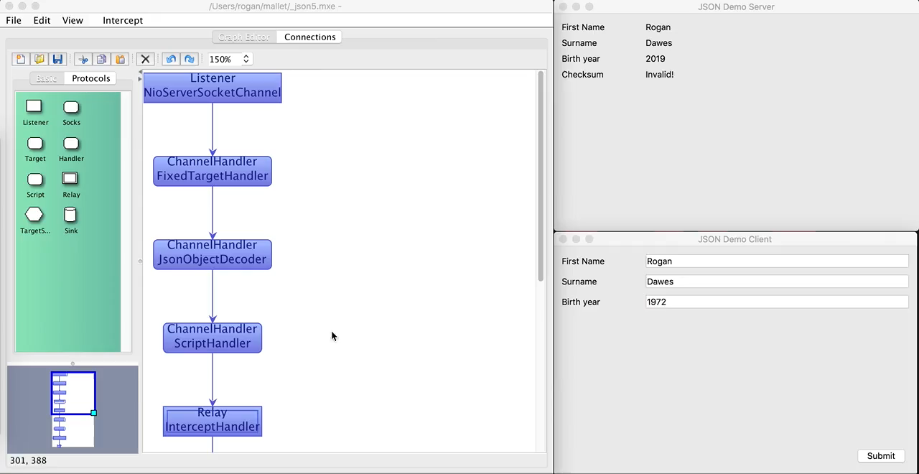

Slide 23
Questions?
https://github.com/SensePost/Mallet
Rogan Dawes
rogan@sensepost.com
@RoganDawes

